Slide 1
Revature Expense Reimbursement System
By Abe Schroeder && Slavik Gleanco

Slide 2
Introduction
JWT Authentication / Authorization
Full-stack Application
Login/Logout/Register
Add/View Reimbursements (Employee)
Add/View/Approve/Deny Reimbursements (Manager)

Slide 3
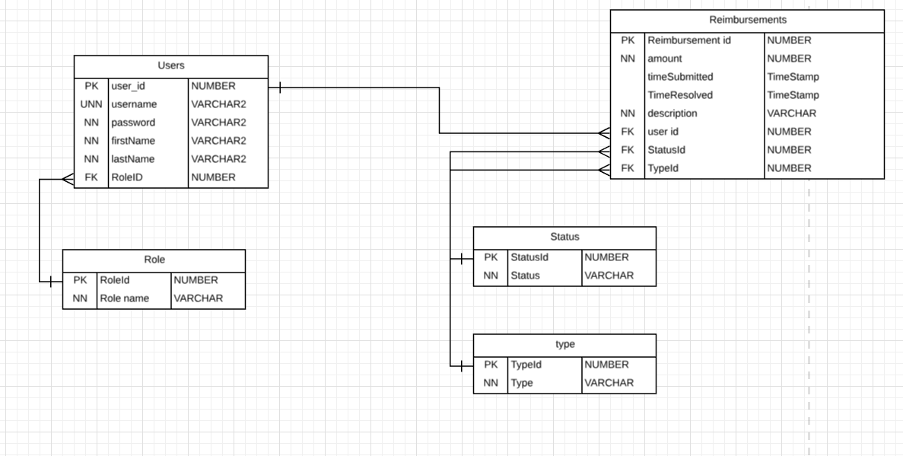

Slide 4
